Slide 1
W2: Recursion
WIA1002/ WIB1002/WXES1117 : Data structure

Slide 2
Recursion
Programming technique where a method calls itself to fulfil its overall purpose.
Also known as Self-Invocation
Condition/Option :
  One option that is recursive
  One option that is non-recursive (base case)
If only one recursive component, recursion would never end.
  Infinite recursion/loop

Slide 3
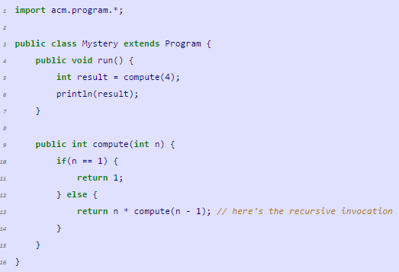
Sample Code

Slide 4
Sample Code
1. temporarily suspend until invocation complete
Engine :
4 * ?
3 * ?
2 * ?
1 Go Up
2. Invocation complete when it reach base case (n==1)

Slide 5
Sample Code
Engine :
4 * 6 = 24 Final Answer
3 * 2 = 6 Go Up
2 * 1 = 2 Go Up
1 Go Up
The compute method basically perform
= 4 * (3 * (2 * 1))
It likes a stack!

Slide 6
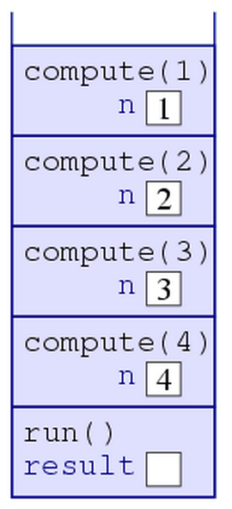
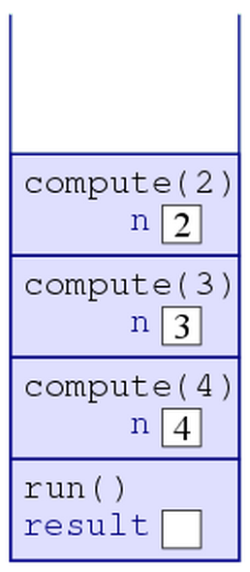
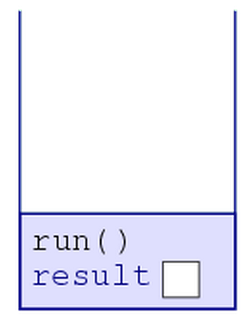
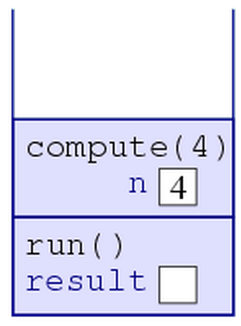
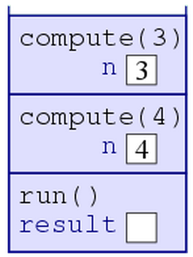
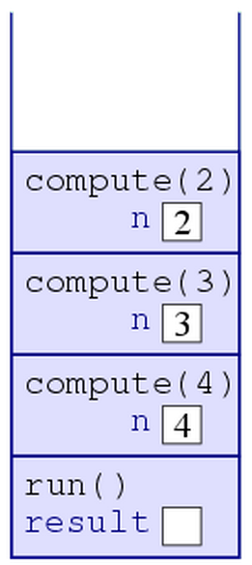
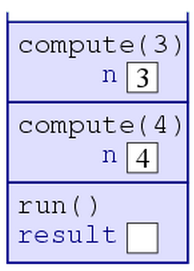
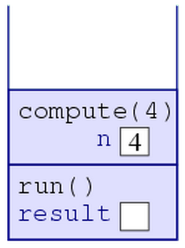
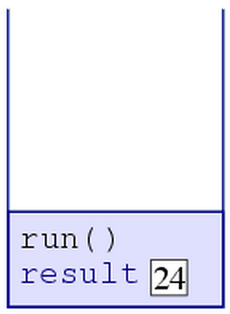
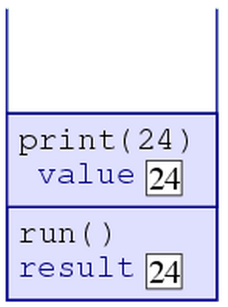
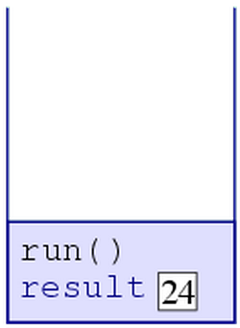
Step 1 Step 2 Step 3
Step 4 Step 5
Step 6 Step 7 Step 8 Step 9 Step 10 Step 11

Slide 7

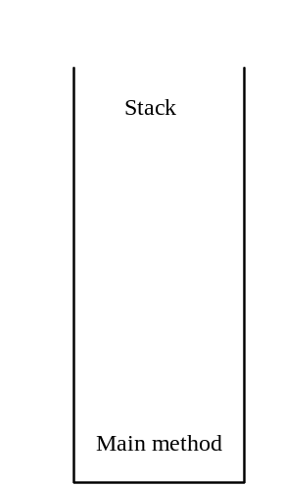
Trace Recursive factorial
animation
1. temporarily suspend until invocation complete
Executes factorial(4)

Slide 8

Trace Recursive factorial
animation
Executes factorial(3)

Slide 9
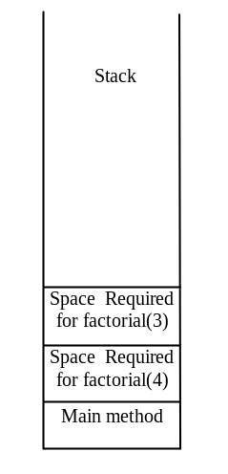
Trace Recursive factorial
animation
Executes factorial(2)

Slide 10
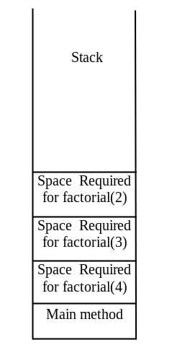
Trace Recursive factorial
animation
Executes factorial(1)

Slide 11
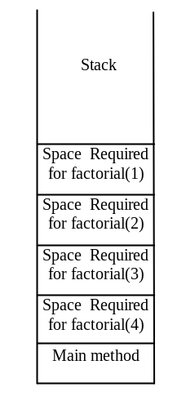
Trace Recursive factorial
animation
Executes factorial(0)

Slide 12
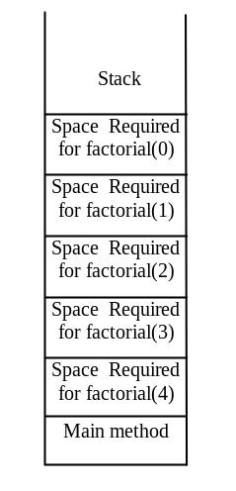
Trace Recursive factorial
animation
returns 1
2. Invocation complete when it reach base case (n==1)

Slide 13
Trace Recursive factorial
animation
returns factorial(0)

Slide 14
Trace Recursive factorial
animation
returns factorial(1)

Slide 15
Trace Recursive factorial
animation
returns factorial(2)

Slide 16
Trace Recursive factorial
animation
returns factorial(3)

Slide 17
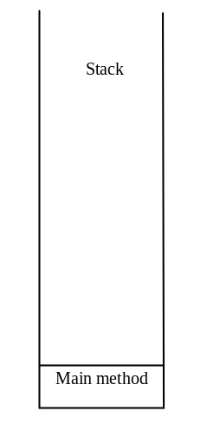
Trace Recursive factorial
animation
returns factorial(4)

Slide 18

factorial(4) Stack Trace

Slide 19
Recursion in math
N! (N factorial)
  3! = 3 * 2 * 1;
  5! = 5 * 4 * 3 * 2 * 1;
  1! = ??
Pattern?
Base case, 1! = 1
Recursive, N! = N * (N-1) for N>1

Slide 20
Check point
Given the following examples,
  5 + 4 + 3 + 2 + 1;
  4 + 3 + 2 + 1;
  3 + 2 + 1;
What is the base case?
Recursion case?

Slide 21
Check point
Given the following examples,
  5 + 4 + 3 + 2 + 1;
  4 + 3 + 2 + 1;
  3 + 2 + 1;
What is the base case? N is 1
Recursion case? = N + (N-1) for N>1

Slide 22
So what happens if a recursive method never reaches a base case?
The stack will never stop growing.
The OS, however, limits the stack to a particular height, so that no program eats up too much memory.
If a program's stack exceeds this size, the computer initiates an exception, which typically would crash the program.
The exception is labeled a StackOverflowError.

Slide 23
What we can observe?
Every recursive method must have a base case or a stopping condition
Every recursive call reduces the original problem, bringing it increasingly closer to a base case until it becomes that case.
Infinite recursion can occur if recursion does not reduce the problem in a manner that allows it to eventually converge into the base case

Slide 24
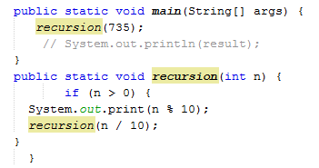
What is the output? What is the base case?

Slide 25
What is the output? What is the base case?
Output : 537
Base case : n <= 0
Note : Every recursive method must not have a return value!

Slide 26
What is the ouput?
public static long factorial(int n) {
return n * factorial(n - 1);
}

Slide 27
What is the ouput?
public static long factorial(int n) {
return n * factorial(n - 1);
}
Output : The method runs infinitely and causes a StackOverflowError.

Slide 28
Recursion vs Iteration
How is this useful? Could write same program using loop!
public class Factorial {
public void run() {
int n = 4;
int result = 1;
while(n > 0) {
result *= n;
n--;
}
System.out.println(result);
}
}

Slide 29
Recursion vs Iteration
Recursion and loops are actually related concepts. Generally, anything you can do with a loop, you can do with recursion, and vice versa. Sometimes one way is simpler to write, and sometimes the other is, but in principle they are interchangeable.

Slide 30
Recursion vs Iteration
Recursion
  Terminate when a base case is reached
  Each recursive call requires extra space on the stack frame (memory)
  If we get infinite recursion, it may result in stack overflow
Iteration
  Terminates when a condition is proven to be false
  Each iteration does not require any extra space
  An infinite loop could loop forever since there is no extra memory being created

Slide 31
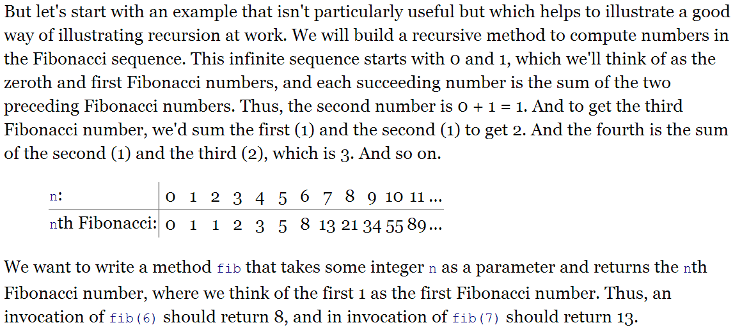
Fibonacci Numbers
The Fibonacci series begins with 0 and 1, and each subsequent number is
the sum of the preceding two numbers in the series

Slide 32
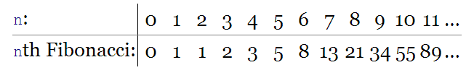
public int fib(int n) {
if(n <= 1) {
return n;
} else {
return fib(n - 1) + fib(n - 2);
}
}
public int fib(int n) {
if (n == 0) return 0; // Base case
else if (n == 1) return 1; // Base case
return fib(n - 2) + fib(n - 1);
}
}

Slide 33
Characteristics of Recursion
All recursive methods have the following characteristics:
  One or more base cases (the simplest case) are used to stop recursion.
  Every recursive call reduces the original problem, bringing it increasingly closer to a base case until it becomes that case.
In general, to solve a problem using recursion, you break it into subproblems. If a subproblem resembles the original problem, you can apply the same approach to solve the subproblem recursively. This subproblem is almost the same as the original problem in nature with a smaller size.

Slide 34
Disadvantage of Recursion
Recursion bears substantial overhead. Each time the program calls a method, the system must assign space for all of the method’s local variables and parameters. This can consume considerable memory and requires extra time to manage the additional space.

Slide 35
Advantage of Recursion
Good for solving the problems that are inherently recursive.

Slide 36
Problem Solving Using Recursion
Let us consider a simple problem of printing a message for n times. You can break the problem into two subproblems: one is to print the message one time and the other is to print the message for n-1 times. The second problem is the same as the original problem with a smaller size. The base case for the problem is n==0. You can solve this problem using recursion as follows:
public static void nPrintln(String message, int times) {
if (times >= 1) {
System.out.println(message);
nPrintln(message, times - 1);
} // The base case is times == 0
}

Slide 37
http://www.toves.org/books/java/ch17-recur/index.html#fig1
http://www.dcs.ed.ac.uk/teaching/cs1/CS1/Ah/Notes/RecursionAndStacks.pdf

